Slide 1
Management Issues in Software Engineering
Comp 8081

Slide 2
Overview
Effective software development practices
Psychological type issues
Software development risk management
Software development lifecycle management
Customer requirement management
Motivation and team issues
Reviews and inspection management
Course is counterpoint to Comp 7081
Notes:
Course doesn't try to be consistent with Comp 7081 which worries more about the technical details.
Focus leads more toward balance of scientific and information processing systems
Emphasis more on non waterfall lifecycles

Slide 3
Instructor
Bruce Link
Ph.D. Computer Science, 1976
5 years experience in US research laboratory
17 years experience at MacDonald Dettwiler
Project Engineer, Project Manager, Engineering Manager
Led projects in excess of 350,000 Lines
Recent projects: Canadian Space Station, Canadian Automated Air Traffic System
BCIT Option Head for Information Systems since 1999
Notes:
Currently investigating cross-compilation systems for embedded systems

Slide 4
Texts
Rapid Development by Steve McConnell, Microsoft Press, 1996
Introduction to Type by Isabel Briggs Myers, Fifth Edition, Consulting Psychologists Press, 1993
Introduction to Type in Organizations by Sandra Hirsh and Jean Kummerow, Second Edition, Consulting Psychologists Press, 1990
Notes and handouts
Notes:
Text presents number of colourful opinions
Students expected to form own opinions about text and material in class
Challenging encouraged
First 16 chapters in text are the main substance, last 27 chapters are a short discussion on best practices.

Slide 5
Format
15 3 hour classes
2 10-minute breaks per class
Lecture plus discussion
  seminar format
Class participation encouraged
Some opinions controversial

Slide 6
Effective Software Development Practices
Rapid development strategies
Typical software mistakes
Software development fundamentals
Core issues in rapid development
Corporate software maturity
Notes:
Covers chapters 1-4 and 6 in main text
Software maturity stuff is all from notes

Slide 7
Psychological Type Issues
Your Myers-Brigs type preference
Type development dynamics
Other’s type preferences
Effects of type on
  problem solving
  dealing with change
  communication preferences
  leadership
  team issues
Notes:
From notes. Two pamphlets are references.

Slide 8
Software Development Risks
Project risks
Benefits of proper risk taking
Responsibility for risk
Controlling project risks
Notes:
Chapters 5 and 16 in the text, plus notes

Slide 9
Software Development Lifecycles
Selecting software development lifecycles
  Agile
  Disciplined
Estimating effort and schedule
How to beat schedule pressures
  Negotiation
Notes:
Chapter 7-9, 20,21,36

Slide 10
Customer Requirements
Customer management techniques
Requirements versus solutions
Testable attribute requirements
Critical attribute requirements
Notes:
Chapters 10, 14 plus notes

Slide 11
Applied Personnel Issues
Motivation factors
Guidelines for teams
Team structure
Notes:
Chapters 11-13

Slide 12
Project Problems
Methods to control feature creep
Disaster recovery plans

Slide 13
Managing Reviews and Inspections
Benefits of inspections
Inspection roles
Inspection products
Planning inspections
Conducting inspections
Notes:
Chapter 23 plus mainly notes

Slide 14
Welcome to Rapid Development
What is rapid development?
Notes:
Ask the class
Here the focus will be on developing faster by reducing wasted effort (usually improving quality at the same time).

Slide 15
Rapid Development Strategies
Objective:
  After reading the text, the learner will discuss rapid development strategies, correctly describing:
    four practices which lead to the best possible schedule
    four dimensions of development speed
    four different kinds of fast development
    typical problems with common rapid development strategies

Slide 16

Four Practices
Avoid classic mistakes
Apply development fundamentals
Manage risks to avoid catastrophe
Apply schedule-oriented practices
All four are needed
Notes:
Optimum is to have all four
Will have a module devoted to each of the first three,
most of course to fourth
Ask what happens if we ignore the first three and only concentrate on the fourth.
Do not talk details here

Slide 17
Four Dimensions of Development Speed
People
Process
Product
Technology
Notes:
Covered on next slides
First ask them which they think is most important (greatest effect)? Which do they get the most training on? Is there a discrepancy? Why or why not?

Slide 18
People
Most impact on software productivity and quality
  productivity for similarly experienced programmers varies by 10:1
  performance of teams varies by 5:1
Staff selection
Team organization
Motivation
Notes:
Staff selection: Boehm in Software Engineering Economics has 5 principles (from text):
Top talent - use better and fewer people
Job matching - fit tasks to skills and motivation of people available (MBTI was designed to help here)
Career progression - help people progress as they want rather than forcing them to work where you want
Team balance - select people who will complement and harmonize with each other (MBTI again)
Misfit elimination - eliminate and replace problem team members as quickly as possible
Have someone read sidebar on page 14 aloud to class

Slide 19
Process
SEI work on software maturity levels
Rework avoidance
Quality assurance
Development fundamentals
Risk management
Resource targeting
Lifecycle planning
Customer orientation
Notes:
Raytheon went from 41% rework down to 10% rework going from level 2 to level 4 of software maturity, 1995
QA: product and process. Here focus is on process that reduces defect cost by early removal module G.
Development fundamentals module A3
Risk management module C
Resource targeting, reduces wasted efforts, misscheduling, unproductive office environments
Lifecycle planning module D
Customer orientation module E - half of job is typically helping the customer figure out what the requirements actually are. Staged releases, evolutionary delivery, evolutionary prototyping and throwaway prototyping help here

Slide 20
Product
Most tangible dimension
Offers schedule reduction by reducing feature set.
80/20 rule: 80% of product takes 20% of time
  how much of remaining 20% can be deferred?
Two aspects
  product size
  product characteristics
Notes:
Larger projects take disproportionately more time & effort
can defer less essential features, or eliminate unnecessary ones (defer forever) - mind set and lifecycle that does the most essential first.
Characteristics may have unreasonable effect if they are extreme - performance, memory use, reliability, etc.

Slide 21
Technology
Gets the most interest
Only works if you handle the learning curve properly and chose wisely
Usually does not deliver compared to the other three areas
Notes:
Ask for examples
Ada vs C factor of two difference.
Going from 3GL to 4GL big schedule advantage if performance and reliability adequate
string vs weak typing - some tools such as plumber try to make up for language weakness.
Sometimes process (inspection) can make up more than better tools.

Slide 22
Kinds of Fast Development
Average practice
Efficient development
  balancing cost, schedule, functionality
Efficient development tilted toward best schedule
  compromises cost and product
All-out rapid development
  sacrifices cost and product
Notes:
Efficient development is just handling the first three pillars: classic mistake avoidance, development fundamentals, risk management
Efficient development already improves all of schedule, cost product - may give good enough schedule improvement
See figure 2-5 in book, p 20 - efficient development is on road to rapid development (tilted toward best schedule)
All out rapid development usually not desirable, as affects cost and quality/features too much

Slide 23
Alternative Approach
Get the best people, get total commitment to the project, give them full autonomy, extreme motivation, and work them 60-100 hours/week
  NT 3.0
  Data General Eagle Computer (see The Soul of a New Machine, Tracy Kidder, 1981)
Guarantees extraordinary sacrifice but not extraordinary results
Notes:
Have class discuss this. “code-like-hell” approach. Points from book:
Approach is hit-or-miss
Causes long term motivation problems - burnout or discouragement if miss their commitments - TMBPS
Unrepeatable
Hard on nonsoftware organizations - based on heroics rather than coordination, cooperation and planning
Wastes human resources extravagantly

Slide 24
Classic Mistakes

Slide 25
Objective
After reading the case study of a typical software project and given the list in the book of the 36 classical mistakes, the learner will correctly list 90% of the classical mistakes committed by the team in the case study

Slide 26
Effect of Mistakes
Illustrative study from ITT researchers shows
  poor use of individual productivity practices gives poor productivity
  good use of a single productivity practice can still give poor productivity
It is not enough to do some things right, and ignore other things
Have to eliminate most or all of the mistakes

Slide 27
People-related Mistakes 1/2
Undermined motivation
Weak personnel
Uncontrolled problem employees
Heroics
Adding people to a late project
Noisy, crowded offices
Notes:
Some of these, like heroics are often thought to be good - what are the problems with it
Any other surprises here?
Mythical Man-Month, Fred Brooks, 1975 - out in 25 year edition.
Psychology of Computer Programming, Gerald Weinberg, 1971 coming out shortly

Slide 28
People-related Mistakes 2/2
Friction between developers and customers
Unrealistic expectations
Lack of effective project sponsorship
Lack of stakeholder buy-in
Lack of user input
Politics over substance
Wishful thinking
Notes:
On average friction between customers and developers becomes so severe that both parties consider canceling the project - Capers Jones, 1994 Assessment and Control of Software Risks
Wishful thinking is closing your eyes and hoping something works when there is no reasonable basis.

Slide 29
Process-related Mistakes 1/2
Overly optimistic schedules
Insufficient risk management
Subcontractor failure
Insufficient planning
Abandonment of planning under pressure
Wasted time during the fuzzy front end
Shortchanged upstream activities
Notes:
Fuzzy front end - the time of approval and budgeting before the project starts - months or years.
Easier and cheaper to save a few weeks in the front end than to compress the development schedule by the same amount - why don’t we? (risk)
Upstream - e.g. RA, architecture, design - don’t produce code

Slide 30
Process-related Mistakes 2/2
Inadequate design
Shortchanged quality assurance
Insufficient management controls
Premature or overly frequent convergence
Omitting necessary tasks from estimates
Planning to catch up later
Code-like-hell programming
Notes:
Inadequate design special case of shortchanged upstream activities
Shortcutting 1 day of QA early in the project costs 3-10 days downstream - Jones 1994 again
Convergence is getting the last things done for release - performance, final docs, final help screens, etc.

Slide 31
Product-related Mistakes
Requirements gold-plating
Feature creep
Developer gold-plating
Push-me, pull-me negotiation
Research-oriented development
Missing critical attributes
Notes:
Users tend to be less interested in complex features than marketing and development are - examples? - and complex features add disproportionately to schedule
push-me, pull-me - this is when schedule slip is approved on a slow project, and then new tasks are added after the schedule slip - DO NOT ACCEPT TASKS WITHOUT LOOKING AT SCHEDULE
Cray - do not attempt to exceed engineering limits in more than two areas at a time because risk of failure too high - if you do not know algorithms, or are pushing new hardware, communications, methods, etc. then good luck - CAATS example
Critical attributes (extra from text) those which cause project failure if not met (e.g. performance, maintainability, etc.)

Slide 32
Technology-related Mistakes
Silver-bullet syndrome
Overestimated savings from new tools or methods
Switching tools in the middle of a project
Lack of automated source-code control

Slide 33
Case Study
Read the case study (pp 29-37)
How many of the mistakes can you identify?
How many mistakes can you see on your current project?

Slide 34
Software Development Fundamentals

Slide 35
Objective
Given ten minutes, the learner will be able to correctly summarize:
  software development fundamentals in areas of management, technical and quality assurance
  assess their relative importance in effects on
    cost
    schedule
    quality

Slide 36
Overview
Path to success: pay attention to fundamentals
Reason to use anything is that it reduces cost and time to market, or improves quality
Lots of these are covered in Comp 7081
product
schedule
cost
Notes:
Discuss classic tradeoff triangle

Slide 37
Management Fundamentals
Estimation and Scheduling
  estimate size, then effort, then schedule
Planning
  poor planning allows problems free rein
Tracking
  75% of sites need to improve project tracking and oversight
Measurement
  data to analyze software quality and productivity
Notes:
Will talk about Capability Maturity Model (CMM) A5
Effort and schedule is D2 and D3
Planning is in lifecycle modules D and team issues F2, F3
What is class experience here?

Slide 38
Technical Fundamentals
Requirements Management
  leverage greatest in requirements activities
Design
  few developers really do design at all (re Microsoft)
Construction
Configuration Management
Notes:
Will talk about feature creep and requirements gathering
This is comp 7081 stuff - see text

Slide 39
Requirements Management
Methodologies - structured analysis, object-oriented analysis
Class diagrams, dataflow diagrams, entity relationship diagrams, data-dictionaries, state-transition diagrams
Lifecycle interactions - evolutionary, staged releases, spiral, waterfall, code-and-fix
50-200 times cheaper to get them right early rather than in construction/ maintenance
Notes:
Critical to get to CMM level 2

Slide 40
Discussion Topic
What is the relative importance of management and technical fundamentals?

Slide 41
Quality Assurance Fundamentals
Cost to find a defect
Testing
Technical reviews - more effective than testing
  walkthroughs
  code reading
  inspections
Audits
Notes:
read sidebar on defects p 72 - cost of defect
products with fewest defect counts have shortest schedules
SEI survey found 60% of organizations suffered from inadequate QA
Problems with shortcutting quality to meet ship dates - class examples?
Reworking defects in ra, design and code consumes 40-50% of total cost of SW development (Jones)
60% of all defects exist at design time (Gilb - inspections)
Unit testing finds 10-50% of defects, system testing 20-60% of defects, cumulative defect-detection rate < 60% ( Jones)
Inspections 60-90% effective in defect removal

Slide 42
Core Issues in Rapid Development
Notes:
Have talked about avoiding classic mistakes, and a bit about development fundamentals - next step is schedule-oriented development practices
First we understand the main issues, then on to the details in later modules

Slide 43
Objective
After reading the text, the learner will discuss core issues in rapid development including:
  needs based on product characteristics
  customer priorities
  project completion probability curves
  separating perception from reality
  where the time goes
  development speed tradeoffs
  typical schedule improvement patterns

Slide 44
Does One Size Fit All?
Different projects have different development needs
  even if they are all ASAP
Quick and dirty practices in life-critical systems may be too rigorous for a business application
Relevant factors:
  extent of distribution
  required reliability
Notes:
See chart in book (6-1, p 110)
Examples from class?
Ask for examples of practices for high and low required reliability: number of reviews, change control, formal problem tracking, amount of documentation

Slide 45
What Kind of Rapid Development?
Several possible needs:
  slight speed edge
  better progress visibility
  lower costs
  maximum speed at any cost
Do not choose fast, if you really want cheap!

Slide 46
Strong Schedule Constraints
Typical product
Value of
Product
Product with strong
schedule constraint
Time
Notes:
Examples of projects with strong or weak schedule constraints?
Fixing Y2K problem, comply with tax laws, release for Christmas season, or to beat competition

Slide 47
Rapid Development
Look-Alikes
Fear of project runaway
  better risk management, estimation and control
Desire for predictability
  efficient development, and schedule risk reduction
Lowest cost
  smaller team and longer schedule
Hard deadline
  if efficient-development enough, use that
Desire for free overtime from company
Notes:
most cases, rapid development is not needed, just efficient development. Only go for all-out rapid development, if really need, as increases cost.
indents are what is more appropriate than schedule-oriented practices
Hard deadline - some rapid development practices increase schedule risks and may raise probability of missing deadline. If efficient is not good enough, then need to use speed-oriented practices to have a chance.
Sometimes aggressive schedule is just to motivate troops, discuss.

Slide 48
Pick Two of Three
Low cost
Short schedule
Great product
What is the priority?
Notes:
As text points out, many popular products have been late.
MS Word for windows 1.0 supposed to take 1 year and took 5
Windows 95 1-1/2 years late

Slide 49
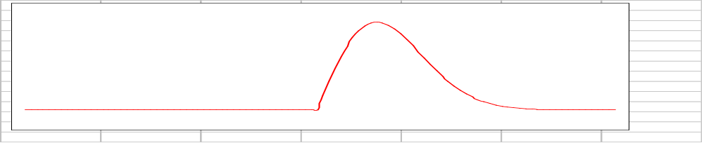
Odds of Completing on Time
Projects have probability of completion curves
Usually skewed to right
Some date is earliest possible completion date
No limit on latest completion date
Probability of
Completion on
Specific Date
Scheduled Completion Date

Slide 50
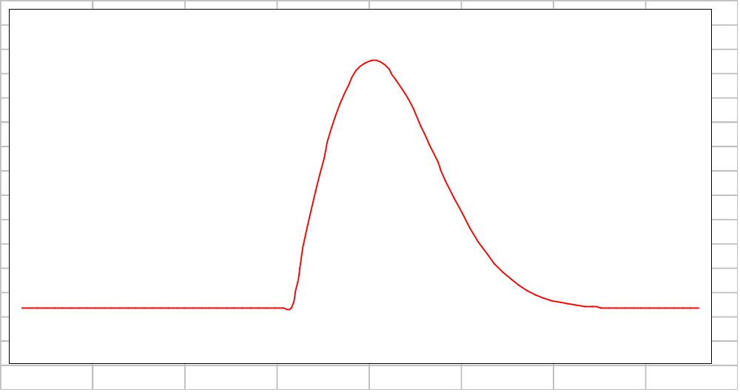
Four Zones
Rapid-development
zone
Slow-development
zone
Impossible-development
zone
Efficient-development zone
Notes:
Dashed line is 50-50 point
These do not really handle different practices,
see next slides

Slide 51
Perception and Reality
How a customer reacts to you depends on expectations
Most projects scheduled on left of 50% chance of completion time line
Most projects finish to right of 50% chance of completion time line
Notes:
Ask why ? - they try to meet schedule and fail - wasting effort in the process
If schedule is in impossible zone, then even efficient practice will be perceived as failure
Discuss overcoming perception - 2 cases, reality (fix with better practices) or not (make schedule realistic, educate customer, give customer visibility)

Slide 52
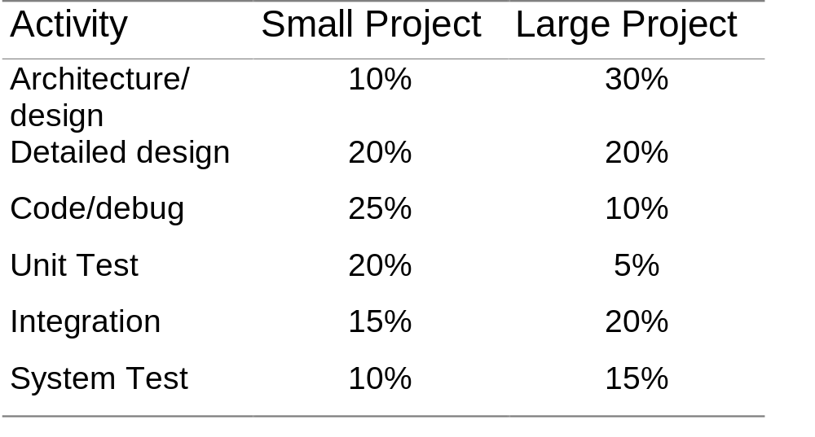
Where the Time Goes
Notes:
From code complete (McConnell 1993)
small 2500 loc
large 50,000 loc
After RA is done!!

Slide 53
Where to Save?
Rework
Feature creep
Better requirements analysis
Pre-contract activities
  cheapest and most effective schedule advancement opportunity
Notes:
Capers Jones reports industry 35% efficient, 65% waste
reworking req,design,code is 40-50% of devel
Feature creep adds 25% reqts during development, adds > 25% to effort
RA typically 10-30% of project schedule, often in relaxed mode - Joint Application Development (JAD), evolutionary proto or development, staged releases help
Also team often changes betw prop and contract

Slide 54
Development-Speed Tradeoffs
Trade-off triangle
Customer or management can’t control all corners
Schedule
Cost
Product/Quality
Notes:
Why does this come up again and again? - important and not well understood
From book - let customers hold corners they want to control, then we balance with what we control - if we get no corners, it may not be possible to do the job!!
Report cited is 30-40% of projects have no corners to control.
Quality - defects lengthen schedule so better quality is faster. Other quality attributes ( e.g. performance, usability, etc.) lengthen schedule and can be traded off to meet schedule

Slide 55
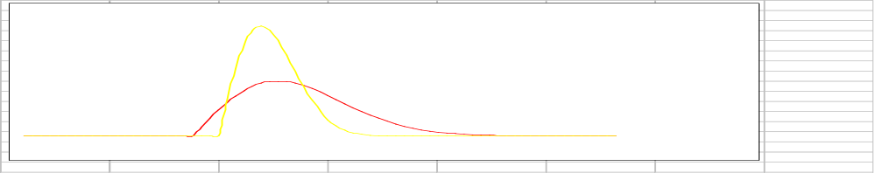
Schedule-Improvement Patterns
First identify wishful thinking
Then go towards efficient development
Planned
schedule
Planned schedule
Notes:
narrow curve has less variation, it is more predictable
Also planned schedule is closer to 50-50 point (discuss where we want it

Slide 56
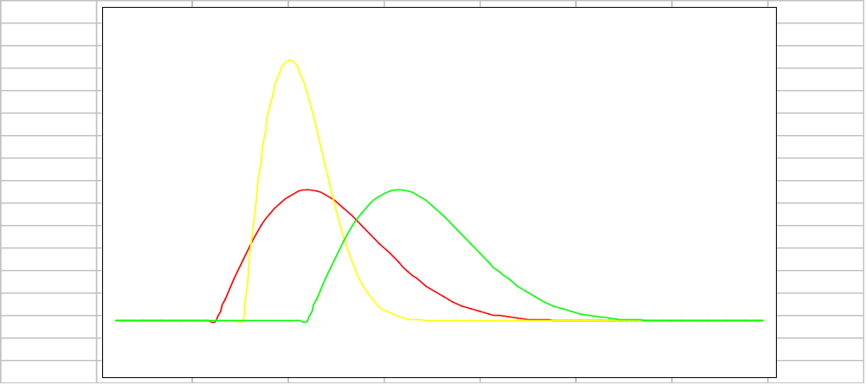
Scheduling Options
Choose with your eyes open
Probability of
Completion
Reduced risk schedule
Increased
speed
schedule
Normal schedule
Scheduled Completion Time

Slide 57
Corporate Software Maturity

Slide 58
Objective
Given a description of a companies development practices
  evaluate its corporate software maturity
  correctly assign it to one of the five software maturity levels, and
  indicate what would be required for the company to advance to the next maturity level

Slide 59
Software Crisis Headlines
Are meeting schedules, budgets, and requirements important?
Software crisis headlines focus on large projects
Most software projects are fairly small
  size of software growing rapidly
  tools and support environment helping professionals to do more
  many small problems sum to crisis!

Slide 60
The State of the Practice?
“I’d rather have it wrong than have it late.”
  senior software manager (industry)
“The bottom line is schedule. My promotions and raises are based on meeting schedule first and foremost.”
  program manager (government)
“By regularly putting the development process under extreme time pressure and then accepting poor-quality products, the software user community has shown its true quality standard.”
  Demarco and Lister (Peopleware, 1987)

Slide 61
Software Engineering Institute
Federally funded research and development centre
Affiliated with Carnegie Mellon University
Established in 1984
Funded to investigate ways of improving company software abilities

Slide 62
Process Management Premise
Quality of system largely determined by quality of process used to develop it
Improvement focus should be on process as well as product
Similar to Total Quality Management movements in manufacturing and service industries

Slide 63
Capability Maturity Model (CMM)
Model of corporate software maturity
Five levels
  1: Initial
  2: Repeatable
  3: Defined
  4: Managed
  5: Optimizing
Levels exhaustively defined

Slide 64
CMM Definition
A description of the stages through which software organizations evolve as they define, implement, measure, control, and improve their software process
A guide for selecting process improvement strategies
  determination of current process capabilities
  identification of the issues most critical to software quality and process improvement

Slide 65
Key Process Areas
Identify a cluster of related activities that achieve a set of goals considered iportant for enhancing process capability
Defined to reside at a single process level
  should master all at one level before trying the ones at the next level
Identify the issues that must be addressed to achieve a given maturity level

Slide 66
Characteristics of the Initial Maturity Level
Performance driven by competence and heroics
Standards driven by management priorities -- usually schedule is more important
High quality and performance possible
Unpredictable
Most software companies reside here

Slide 67
Management View of Software Process at Level 1
Requirements flow in
Software products are usually produced by some amorphous process
The product flows out and hopefully works
In
Out

Slide 68
Characteristics of the Repeatable Maturity Level
Management must “walk the talk” to initiate an improvement effort
Requires management dicipline to retain good software engineering practices in the crunch
Management processes establish role models for process improvement
Management/process discipline empowers the engineering process and staff

Slide 69
Management View of the Software Process at Level 2
Requirement and resources flow in
The production of the software product is visible at defined points
Artifacts of the process are controlled
In
Out

Slide 70
KPA for Level 2, Repeatable
Requirements management
Software project planning
Software project tracking and oversight
Software subcontract management
Software quality assurance
Software configuration management

Slide 71
KPA for Level 3, Defined
Organization process focus
Organization process definition
Training program
Integrated software management
Software product engineering
Intergroup coordination
Peer reviews

Slide 72
KPA for Level 4, Managed
Quantitative process management
Software quality management

Slide 73
KPA for Level 5, Optimizing
Defect prevention
Technology change management
Process change management

Slide 74
On the Other Hand ...
Many factors can adversely affect business survival:
  unreasonable customers
  superior competition
  volatile environment
  changing technology
  poor strategic business planning
  bad business decisions
Process is a “key” subset of concerns

Slide 75
Conclusion
Software process improvement should be done to help the business - not for its own sake
Improvement means different things to different organizations
  what are your business goals?
  how do you measure progress?
Improvement is a long-term, strategic effort
  what is the expected impact on the bottom line?
  how will the impact be measured?

